Slide 1


Slide 2

Family Heritage Life Insurance Company of America (FHL) was founded in 1989. Family Heritage Life became a Globe Life affiliate company in November 2012.
FHL is licensed in 49 states and has local, independently operated offices throughout the country. FHL’s life and supplemental health insurance products are sold by independent insurance sales representatives.

Slide 3

FHL is projected to be a
$2 Billion Asset Company
at the end of 2019
FAMILY HERITAGE LIFE INSURANCE BECOMES $1 BILLION ASSET COMPANY
CLEVELAND-BASED COMPANY RECOGNIZED FOR ATTAINING MILESTONE IN GROWTH
Broadview Heights, OH – June 24, 2016 – Family Heritage Life Insurance Company of America (FHL) has become a $1 billion asset Company. The Company was founded in 1989 in Broadview Heights, OH by Howard Lewis, and began in one small office. FHL was built the old-fashioned way, through hard work and an unwavering belief in people.
“Reaching the $1 billion asset milestone is a true testament of the hard work and dedication of every sales professional and employee in providing top-notch customer service and exceptional insurance coverage to our clients,” said Ken Matson, President of Family Heritage Life.
The road to success for FHL is nothing short of a true American story. Starting out millions of dollars in debt, Founder Howard Lewis began a 26-year commitment to success. Throughout the years he equipped FHL with the strength and reliability it needed to reach milestone after milestone, receiving countless awards along the way. In 2012 FHL became a Globe Life affiliate company (NYSE: GL), leading to even further growth. Howard Lewis’ commitment to steady, stable growth has, in 2016, guided FHL to the $1 Billion Asset milestone.

Slide 4
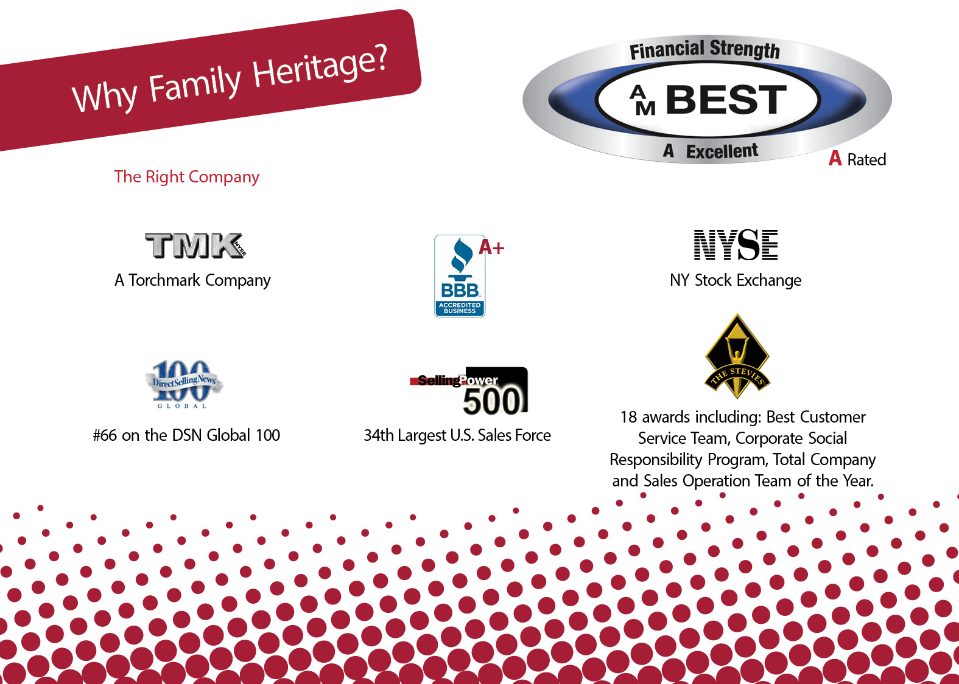
2019 became A+ Superior Rated

Slide 5


Slide 6


Slide 7
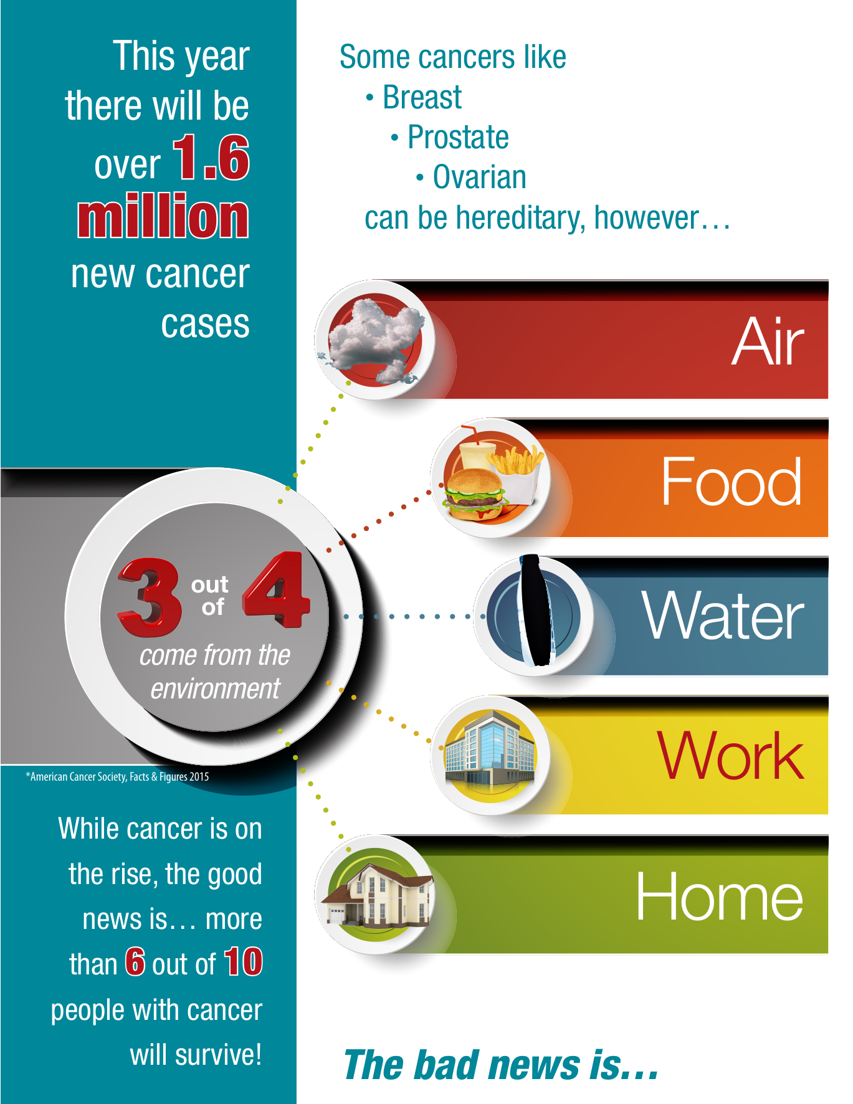

Slide 8
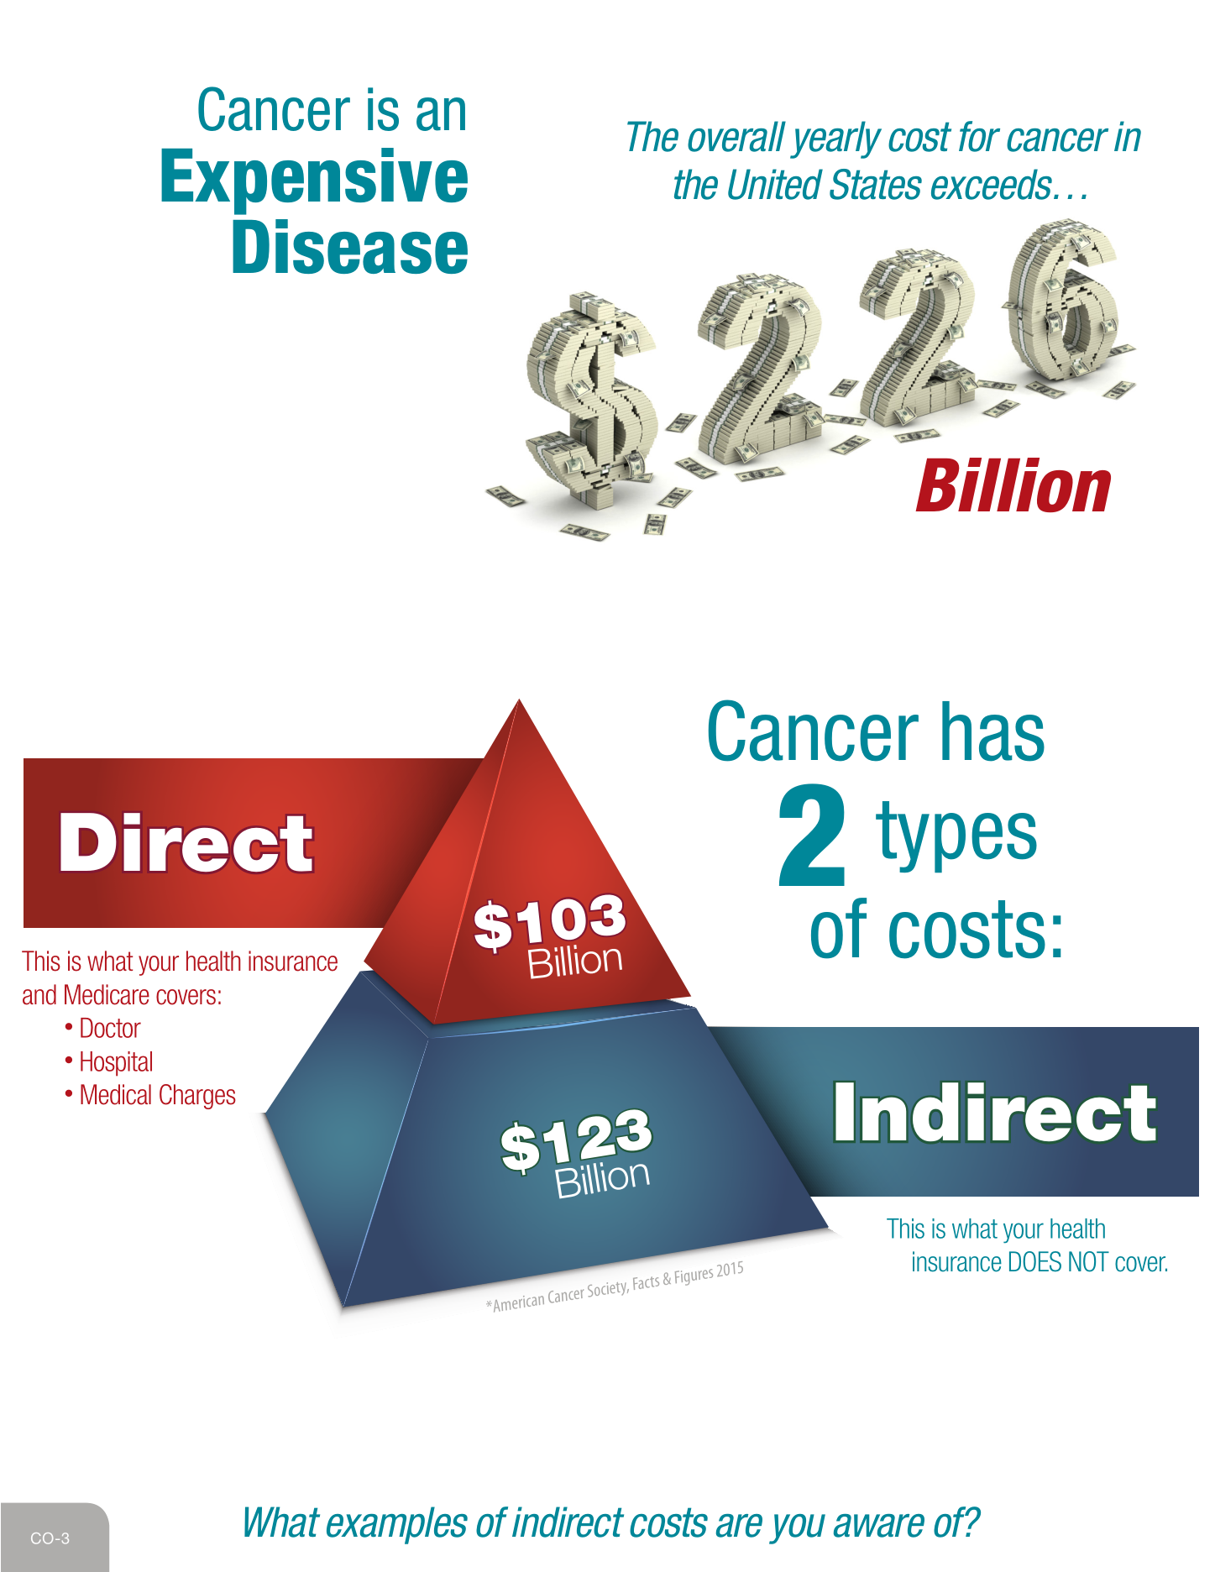

Slide 11


Slide 12


Slide 14
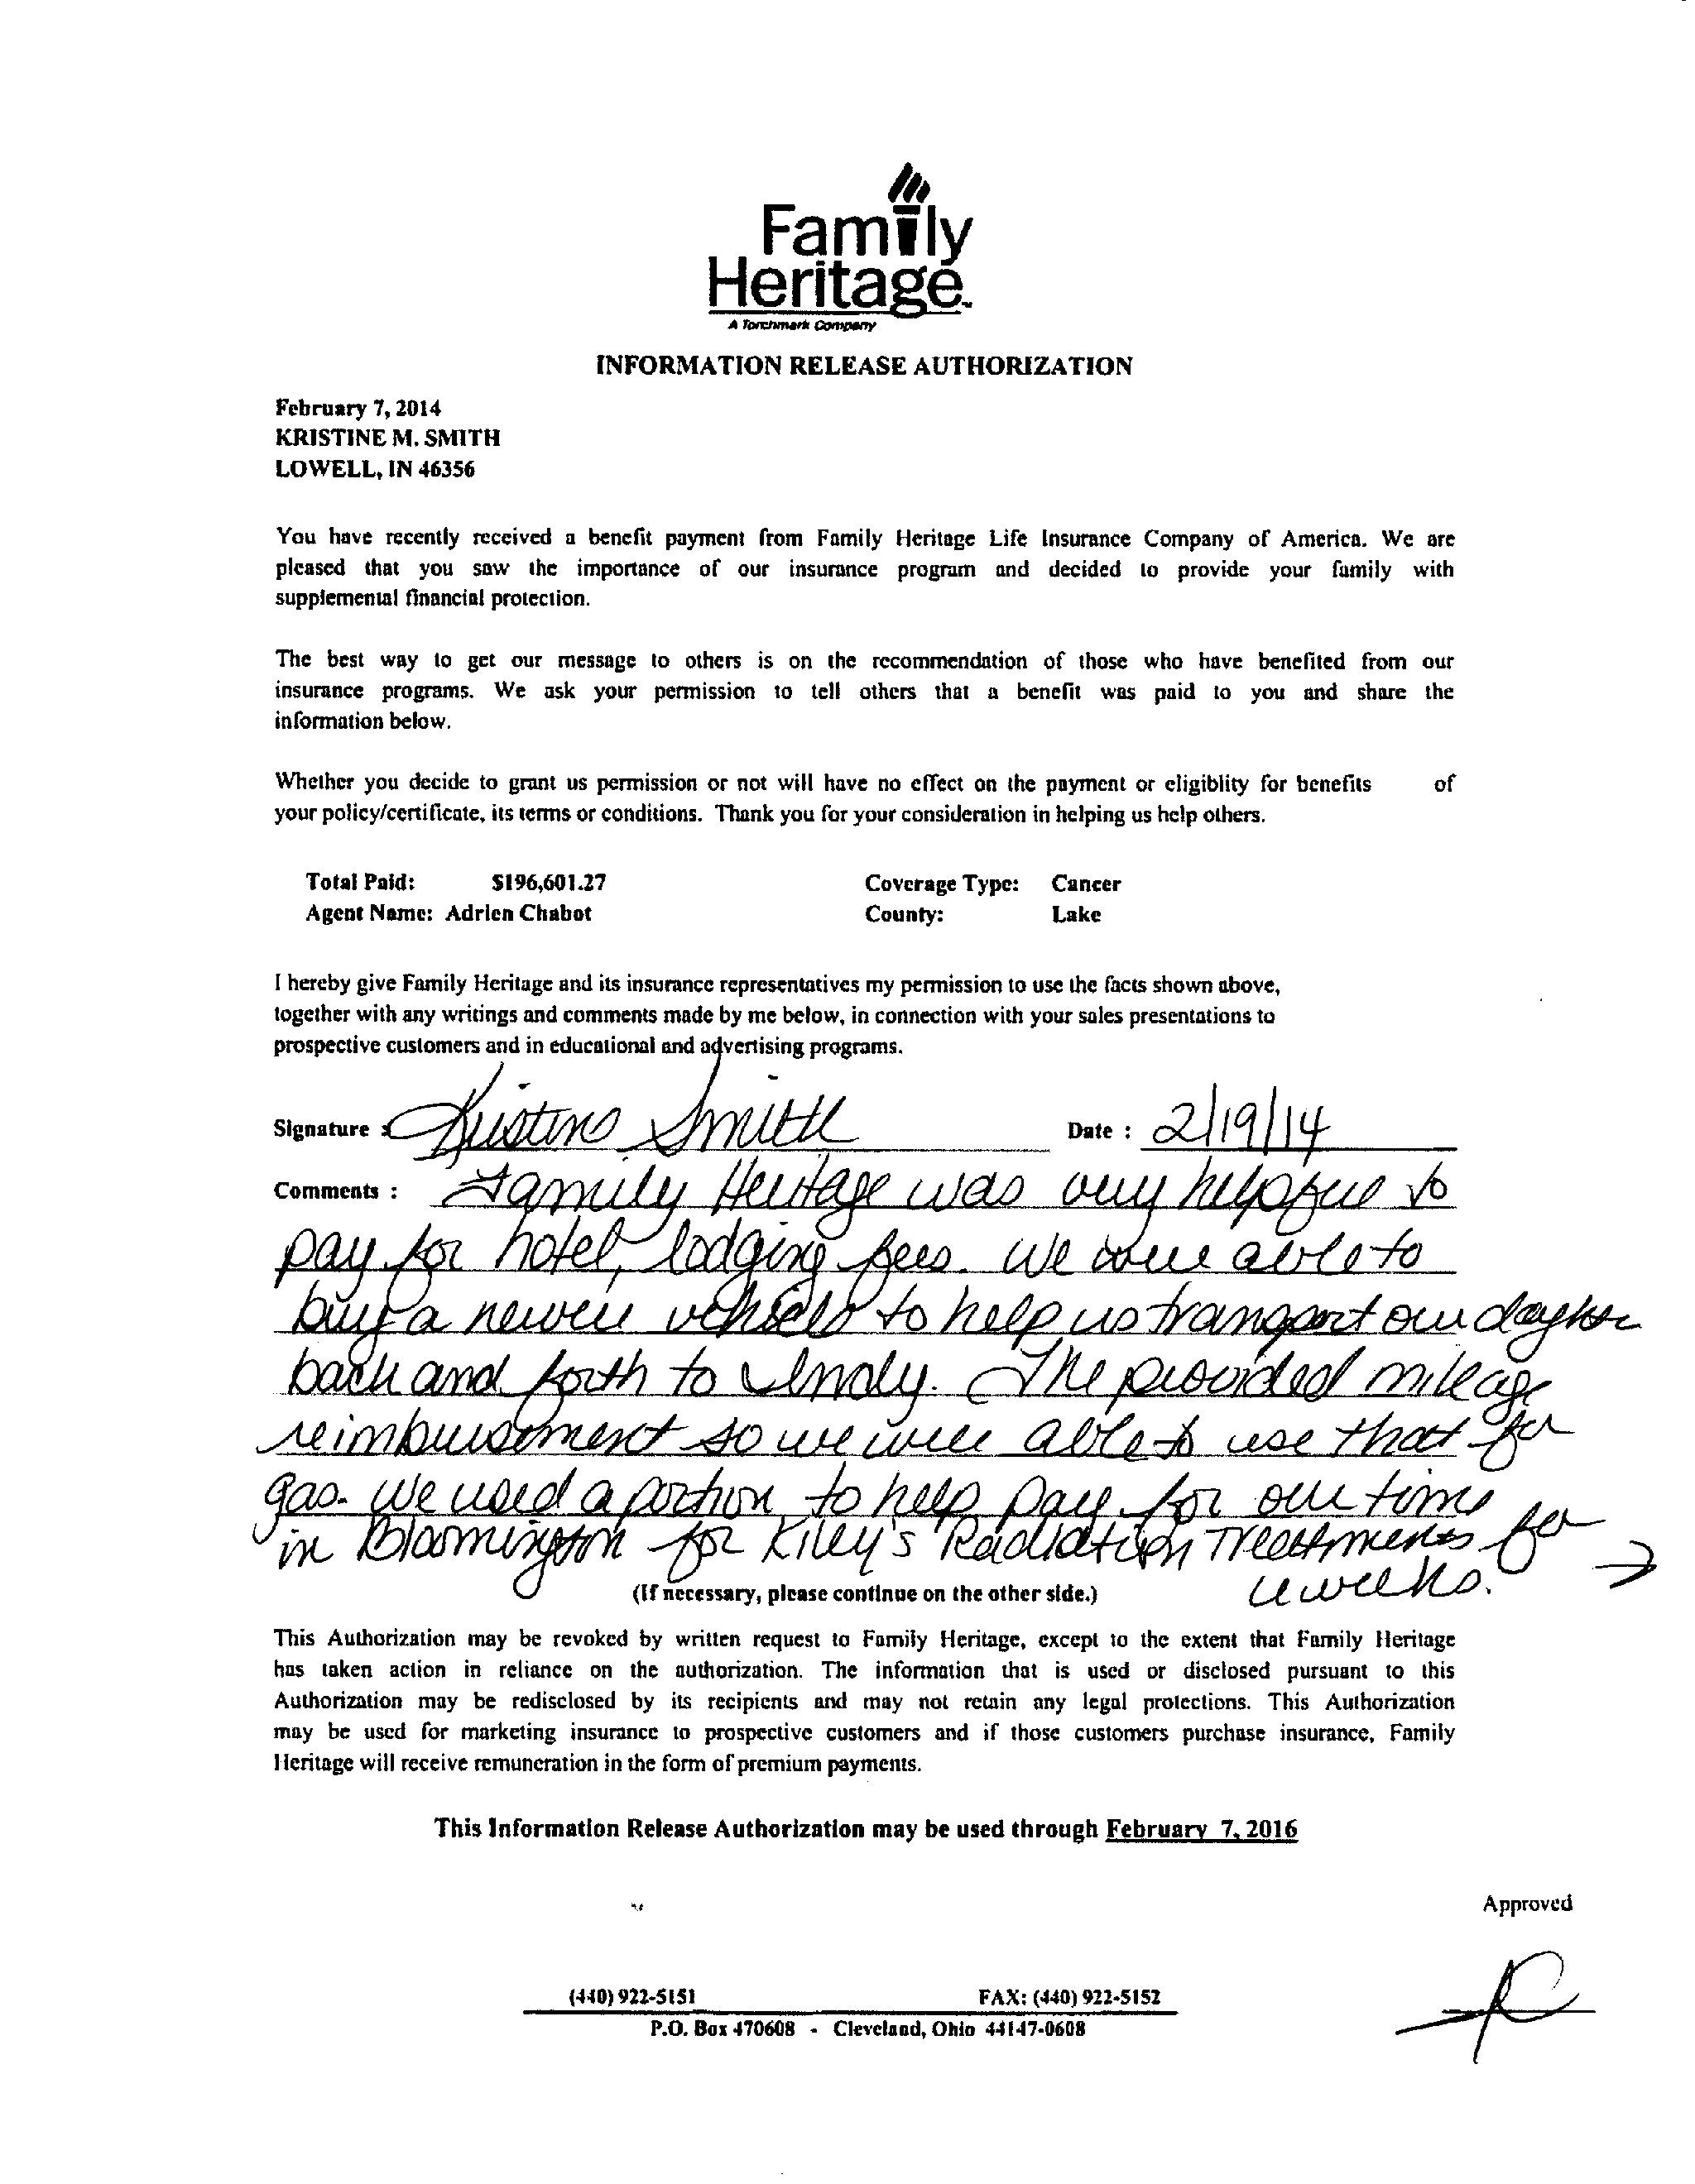

Slide 15
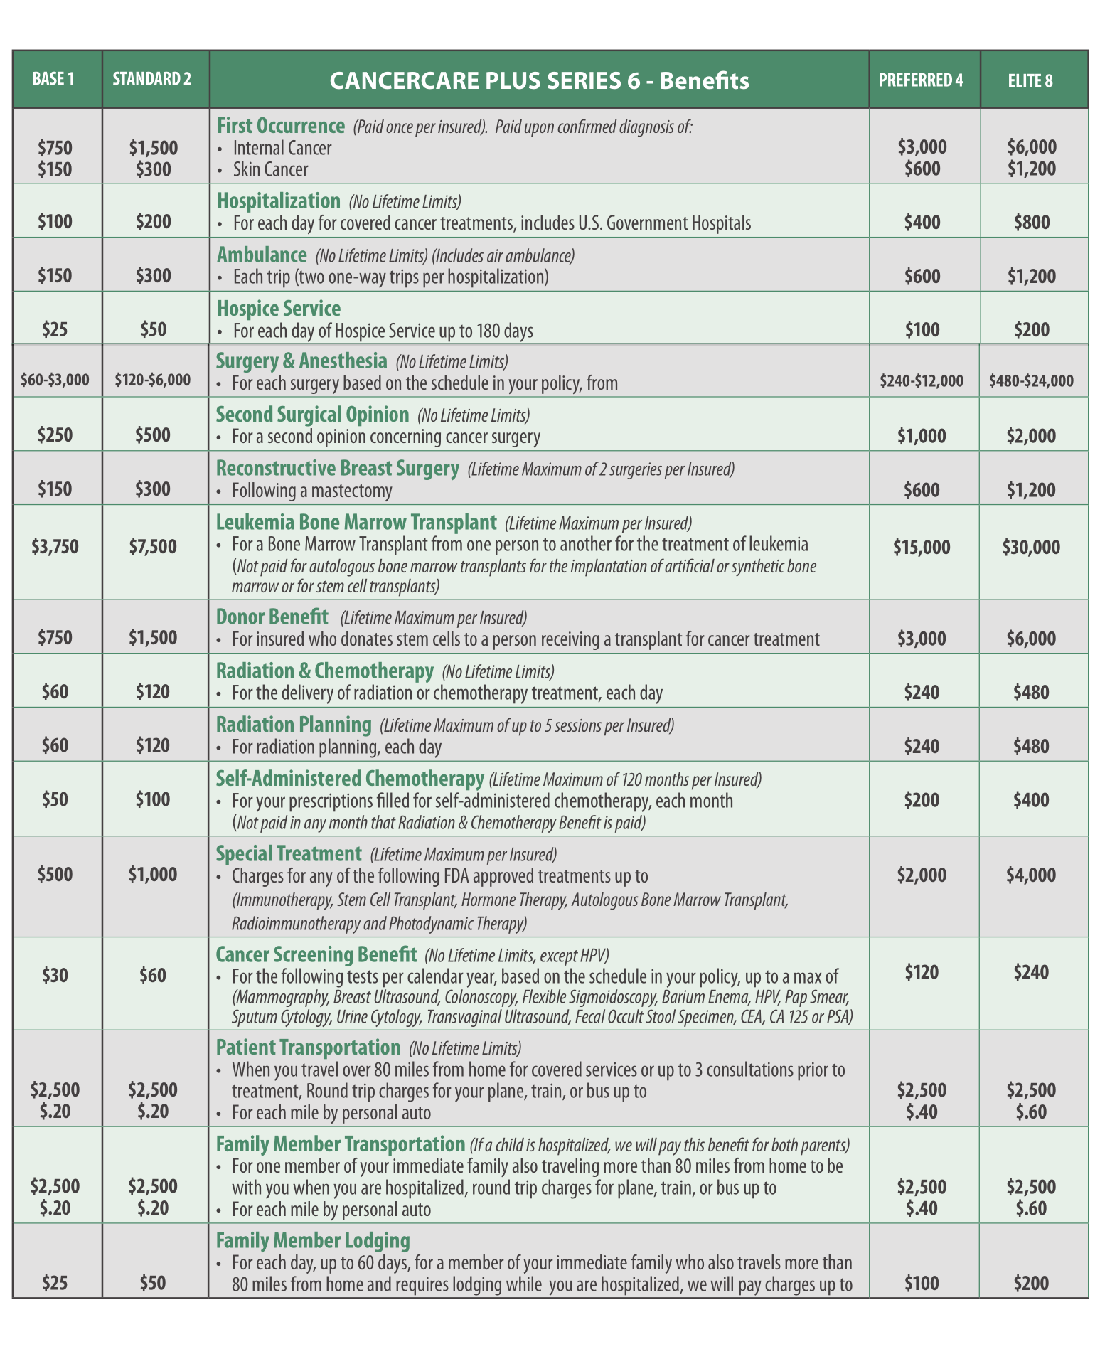

Slide 16
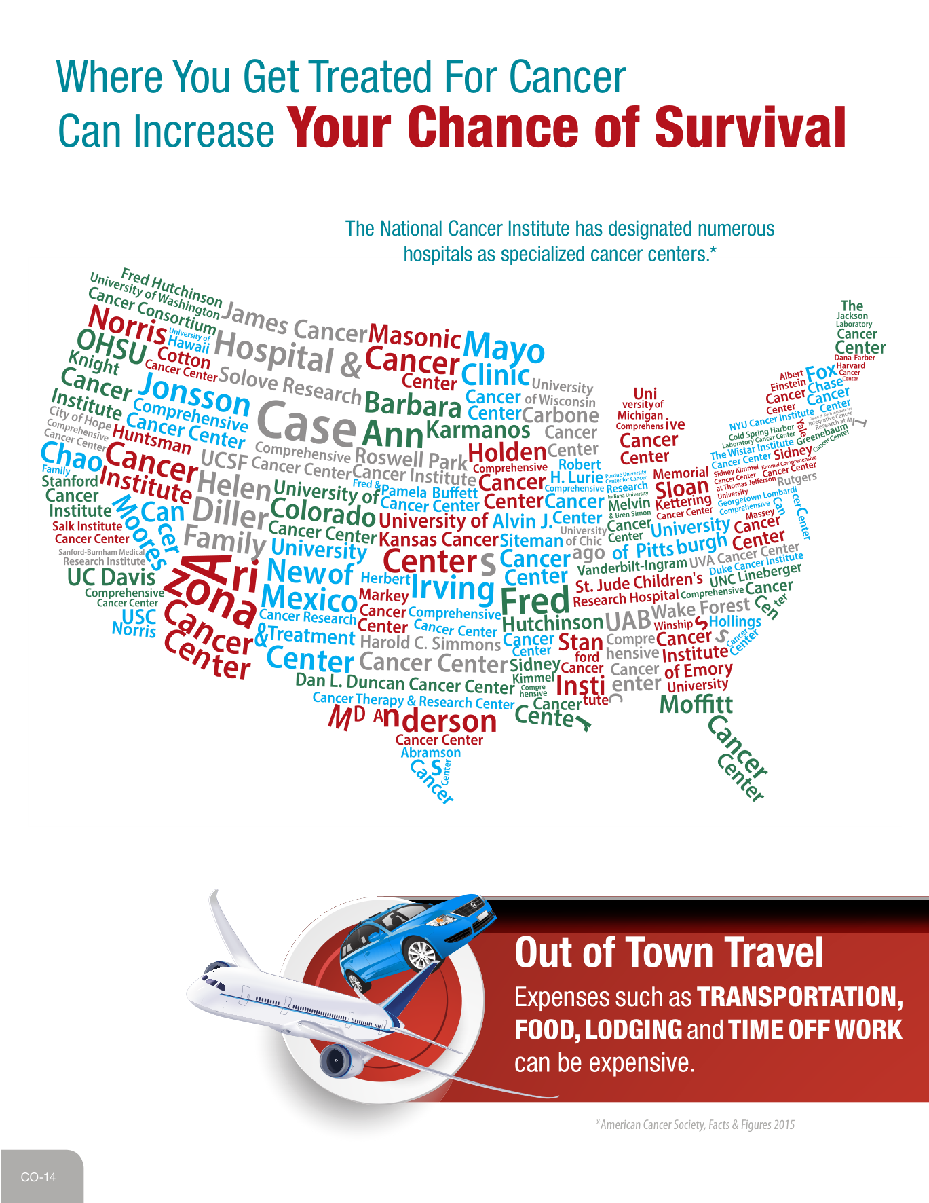

Slide 17
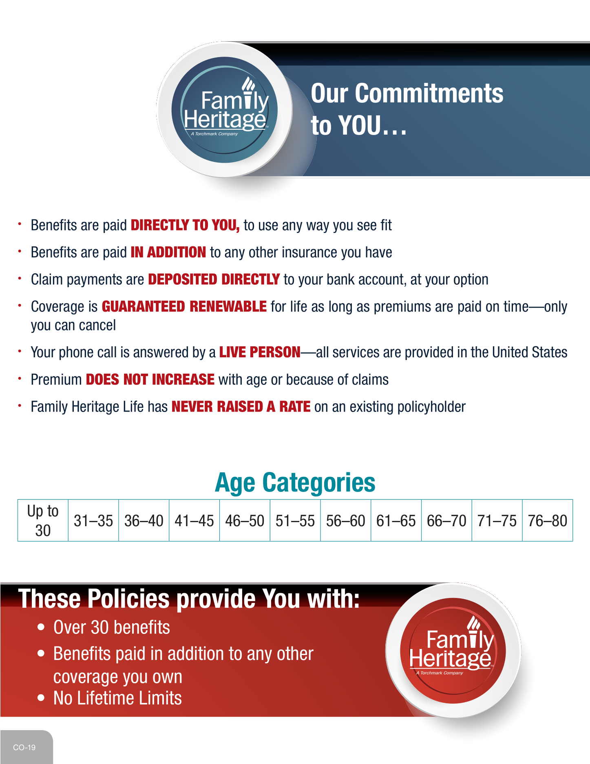

Slide 18
      Cancer
      Heart Attack / Stroke
      Intensive Care
      Accident
      Hospital Confinement

Slide 19
100% Money Back for Non-Use

Slide 21
